Slide 1
COMP6599 – Algorithm and Programming
Week 4
Session 5
Program Control: Selection & Repetition

Slide 2
Sub Topics
Program Control: Selection & Repetition
Selection
Repetition
Break Vs. Continue
Go to and Label
Error Type

Slide 3
Selection

Slide 4
Selection Definition
In an algorithm implementation, an instruction or block of instructions may be executed (or not) with certain predetermined condition
Syntax:
if
if-else
switch-case

Slide 5
Selection : if
Syntax :
if (boolean expression) statement;
or
if (boolean expression) {
statement1;
statement2; Block of statements
……
}
If boolean expression resulting in True, then a statement or some statements will be executed.

Slide 6
Selection : if
Flow Chart of IF Statement
false
true
condition
statements

Slide 7
Selection : if-else
Syntax :
if (boolean expression) statement1;
else statement2;
or
if (boolean expression){
statement1;
statement2;
……
}
else {
statement3;
statement4;
…
}
If boolean expression resulting in TRUE, then statement1 or block statement1 will be executed, if FALSE then statement2 or block statement2 be executed.
Block statement 1
Block statement 2

Slide 8
Selection : if-else
Flow Chart of IF-ELSE Statement
false
true
condition
statements 2
statements 1

Slide 9
Selection : Nested-if
Nested selection occurs when the word IF appears more than once within IF statement.
Syntax :
if (boolean expression) statement1;
if (boolean expression) statement2;
if (boolean expression) statement3;
or
if (boolean expression) statement1;
else
if (boolean expression) statement2;
else
if (boolean expression) statement3;

Slide 10
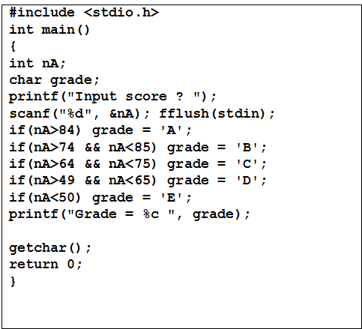
Program Examples Using IF
Example : (Grade Program)

Slide 11
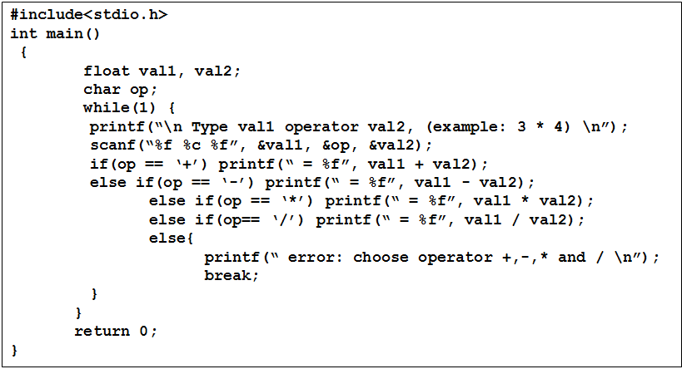
Program Examples Using IF-Else
Example : (Calculator Program)

Slide 12
Selection: SWITCH-CASE
Switch-Case Operation
This statement is used in exchange of IF-ELSE, when if-else nested number of level is enormous and difficult to read
Syntax:
switch (expression) {
case constant1 : statements1; break;
.
.
case constant2 : statements2; break;
default : statements;
}

Slide 13
Selection: SWITCH-CASE
Switch statement evaluate an expression by looking up for each case constant value. If an expression value matches with a case constant value then related statement/s is executed. If nothing match then default statement is executed.
Note:
Expression and constant type should be integer (including char)

Slide 14
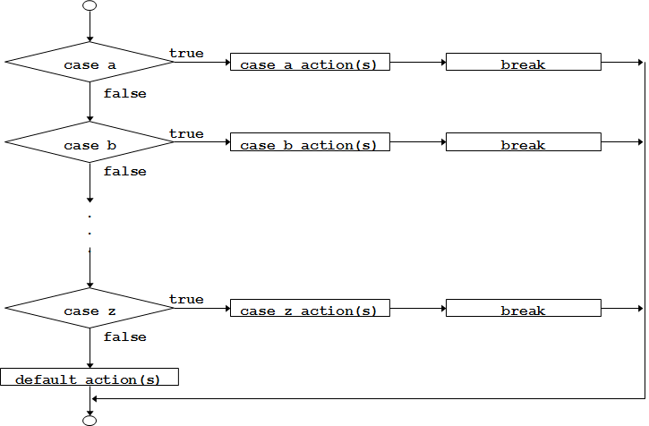
Selection: SWITCH-CASE
Flow Chart of SWITCH-CASE Statement

Slide 15
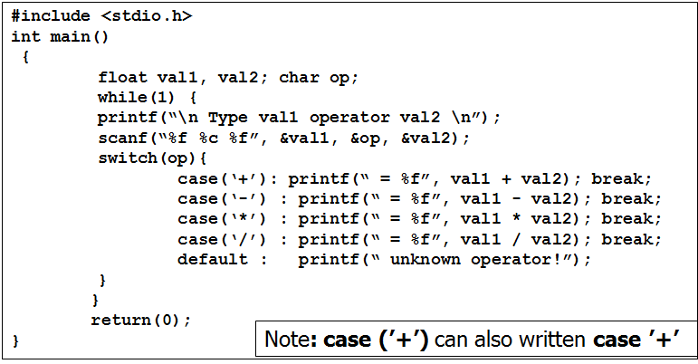
Program Examples Using SWITCH-CASE
Example :

Slide 16
Repetition

Slide 17
Repetition Definition
One or more instruction repeated for certain amount of time
Number of repetition can be predefined (hard-coded in program) or defined later at run time
Repetition/looping operation:
for
while
do-while

Slide 18
Repetition: FOR
Syntax:
for(exp1; exp2; exp3) statement;
or:
for(exp1; exp2; exp3){
statement1;
statement2;
…….
}
exp1 : initialization
exp2 : conditional
exp3 : increment or decrement
exp1, exp2 and exp3 are optional

Slide 19
Repetition: FOR
exp1 and exp3 can consist of several expression separated with comma
Example:
void reverse(char ss[])
{
int c,i,j;
for(i=0, j=strlen(ss)-1; i<j; i++, j--){
c=ss[i];
ss[i]=ss[j];
ss[j]=c;
}
}

Slide 20
Repetition: FOR
Flow Chart of FOR Statement
exp1
exp3
statements
true
exp2
false

Slide 21
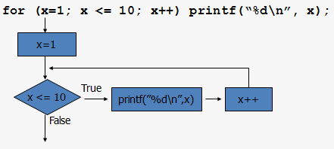
Repetition: FOR
Flow Chart of FOR Statement Example :

Slide 22
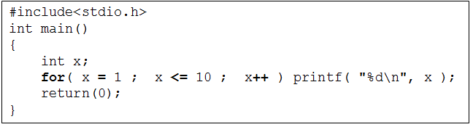
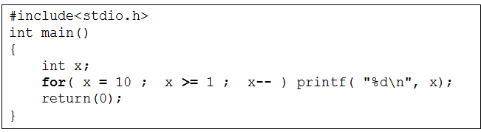
Program Examples Using for
Example :
Program to print out numbers from 1 to 10
Program to print out numbers from 10 to 1

Slide 23
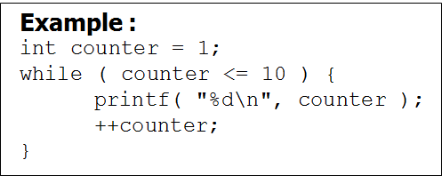
Repetition: WHILE
Syntax :
while (exp) statements;
or:
while(exp){
statement1;
statement2;
…..
}
while (exp) statements;
exp is Boolean expression. It will result in true (not zero) or false (equal to zero).
Statement will be executed while the exp is not equal to zero.
exp evaluation is done before the statements executed.

Slide 24
Repetition: WHILE
Flow Chart of WHILE Statement
statements
condition
true
false

Slide 25
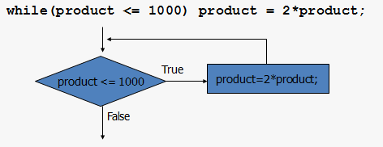
Repetition : WHILE
Example :
In while operation, statement block of statements may never be executed at all if exp value is false

Slide 26
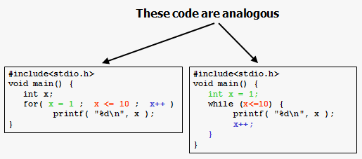
Program Examples Using while

Slide 27
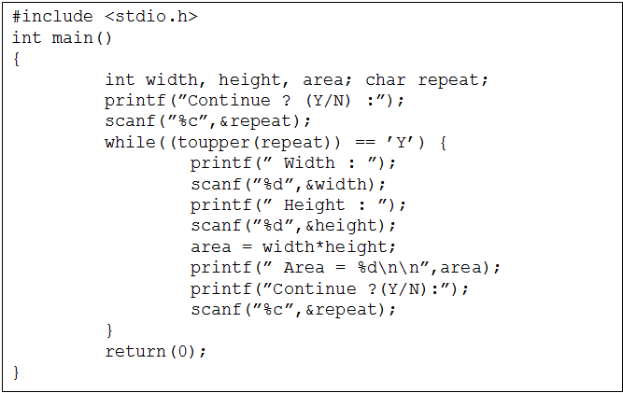
Program Examples Using while
Example: (Question)

Slide 28
Repetition : DO-WHILE
Syntax :
do{
< statements >;
} while(exp);
Keep executing while exp is true
exp evaluation done after executing the statement(s)
Example :
int counter=0;
do {
printf( "%d ", counter );
++counter;
} while (counter <= 10);

Slide 29
Repetition : DO-WHILE
Flow Chart of DO-WHILE Statement
statements
true
condition
false

Slide 30
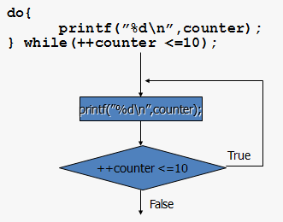
Repetition : DO-WHILE
Flow Chart of DO-WHILE Statement
In do-while on the other hand statement block of statements will be executed min once

Slide 31
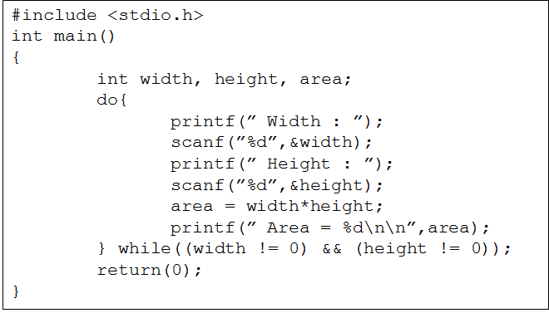
Program Examples Using do-while
Example: (Sentinel)
As sentinel, used 0 for width or height

Slide 32
Break vs Continue

Slide 33
Break vs Continue
break:
ending loop (for, while and do-while)
end the switch operation
continue:
skip all the rest of statements (subsequent to the skip statement) inside a repetition, and continue normally to the next loop

Slide 34
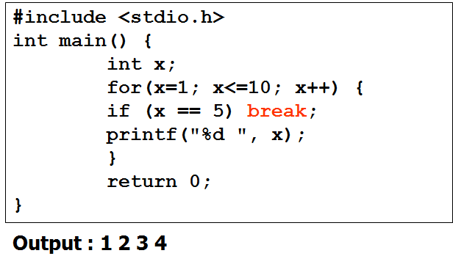
Program Examples Using : break
Example using break:

Slide 35
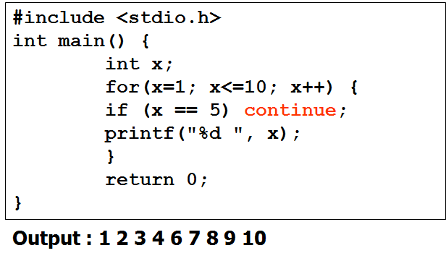
Program Examples Using : continue
Example using continue:

Slide 36
Go to and label

Slide 37
Go To and Label
C is still providing the old fashion goto statement
Syntax:
goto label;
……
label :
……
label is written using colon symbol
Avoid using goto to improve code readability

Slide 38
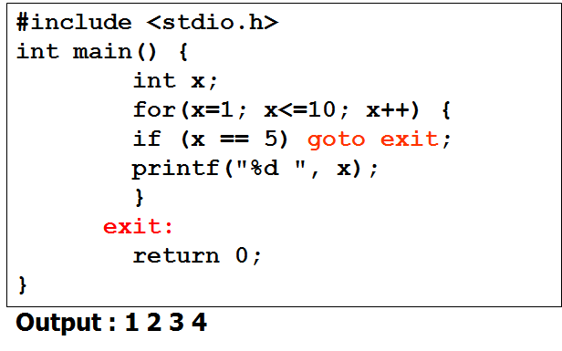
Program Examples Using : goto and labeling
Example using labeling:

Slide 39
Error TYpe

Slide 40
Error Type
Compile-Time Error
caused by syntax error
Link-Time Error
success fully compiled, but cause link error
caused by no object code at link time
Run-Time Error
successfully compiled, but error at runtime. Usually caused by numerical operation such as: overflow, floating point underflow, division by zero, etc.
Logical Error
wrong result caused by incorrect logical flow/algorithm

Slide 41
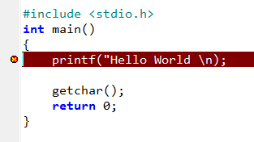
Error Type
Among those Error Types the most difficult to debug is Logical Error.
Example of Compile-Time Error:
Dev-C compiler will give message: In function main missing terminating ” character, syntax error before return

Slide 42
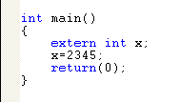

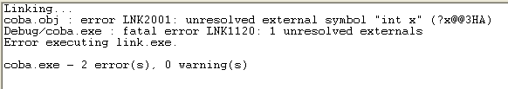
Error Type
Some C compiler merge the compile and link processes, causing in difficulty to distinguish between Compile-Time Error with Link-Time Error
Example of Link-Time Error (Visual C++)

Slide 43
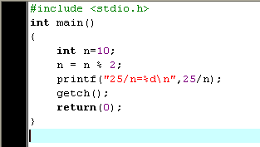
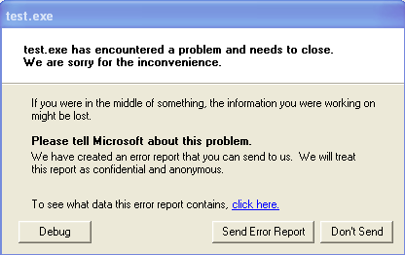
Error Type
Example for Run-Time Error
Error cause:
Division by Zero

Slide 44
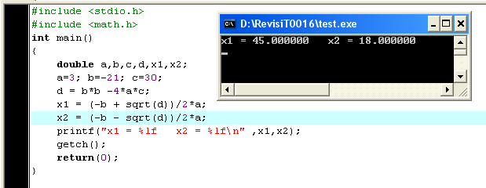
Error Type
Example for Logical-Error
Should be: x1 = 5.00 and x2 = 2.00
Can you find the logic error ??

Slide 45
Summary

Slide 46
Summary
In an algorithm implementation, an instruction or block of instructions may be executed (or not) with certain predetermined condition, that’s why we use selection
3 types of selection in C:
if
if-else
switch-case
Repetition is a condition which is one or more instruction repeated for certain amount of time
3 types of repetition/looping in C:
for
while
do-while

Slide 47
References
Paul J. Dietel,Harvey M. Deitel,. 2010. C : how to program. PEAPH. New Jersey. ISBN:978-0-13-705966-9 Chapter 3 & 4
Choosing between Alternatives: http://docs.roxen.com/pike/7.0/tutorial/statements/conditions.xml
Getting Controls: http://aelinik.free.fr/c/ch10.htm
Doing the Same Thing Over and Over: http://aelinik.free.fr/c/ch07.htm

